Slide 1


Do Transparency Efforts by Election Officials Build Trust in Elections?
Thad Kousser and Lauren Prather

Slide 2

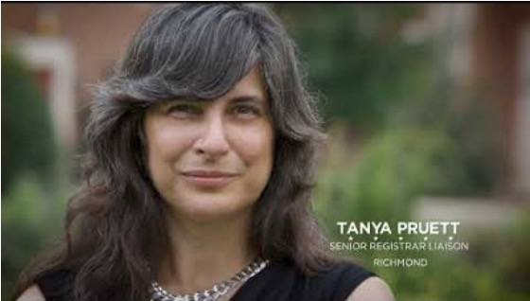

LEOs are making elections more transparent.
We test the impact on trust.
Videos showing the people and processes that protect elections in:
Texas, Georgia, Colorado, California, Arizona, Virginia, Connecticut and Oregon
Tours of election facilities
Maricopa County (AZ), Ada County (ID), Philadelphia (PA)
Jury duty model of poll worker selection
Douglas County (NE)

Slide 3
Short answer: It works!
Factual Communications by Election Officials Build Trust

Slide 4
Why? Because voters trust you
Q. Which of the following sources do you trust when it comes to evaluating the fairness and integrity of elections? Check all that apply. (Data from national survey in December 2025-January 2026)
Local election officials | 29.7% | Candidates | 10.8%
State elections officials | 28.8 | Radio news | 10.2
Television news in my local area | 24.4 | Local business or community leaders | 10.2
Friends and family | 24.2 | Church/Community of Faith | 9.9
Voter guide sent by state & local officials | 23.0 | Podcasts | 8.4
Cable and national news | 20.4 | Facebook | 5.8
Advocacy organizations | 16.0 | TikTok | 5.5
Political leaders in my party | 15.4 | Twitter | 5.2
YouTube | 11.3 | ChatGPT or other generative AI | 4.7
President Donald Trump | 10.8 | Instagram | 4.4

Slide 5
It doesn’t have to be fancy!

Slide 6
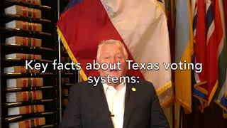
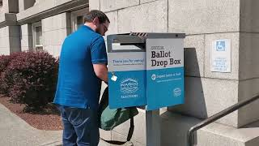
Easy-to-Make Videos Work Great
Wasco County, Oregon
Texas Secretary of State

Slide 7
Lessons on what works best

Slide 8
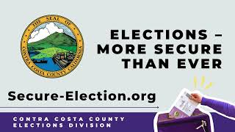

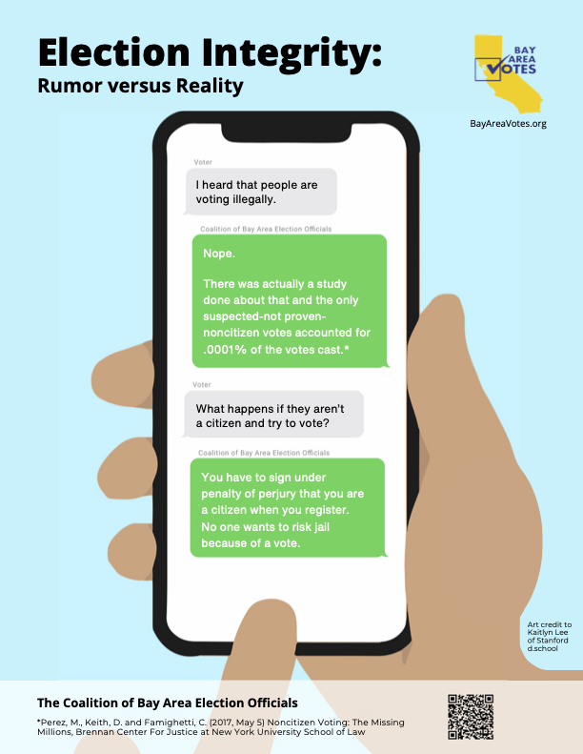
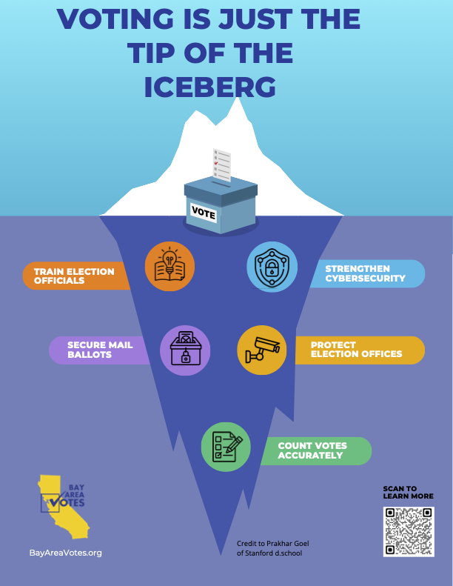

Show election protections, don’t just tell

Slide 9
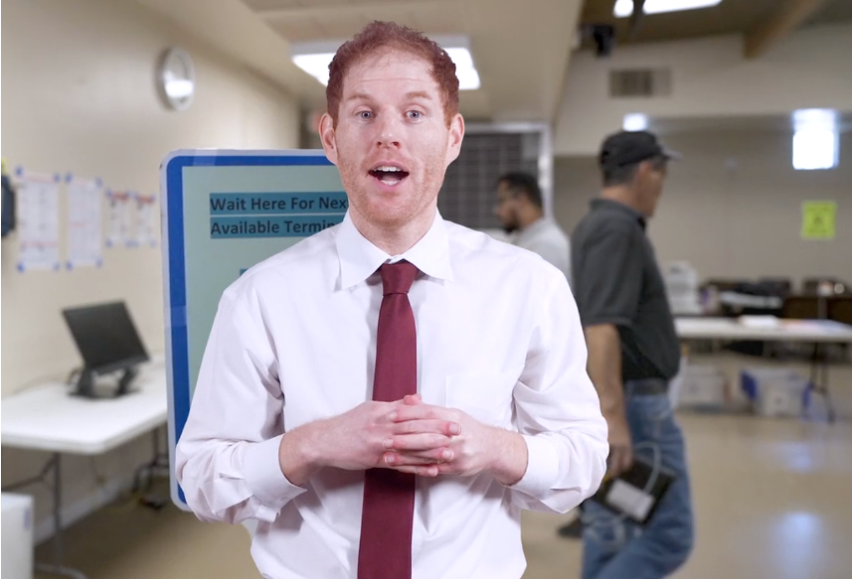
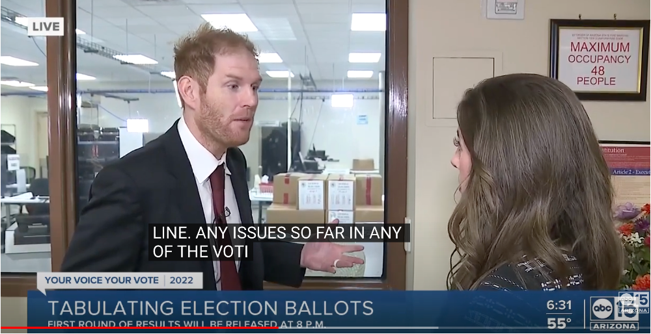
Earned media (appearances on local news) can be just as effective as paid ads
Stephen Richer: Earned Media
Stephen Richer: Paid Media

Slide 10

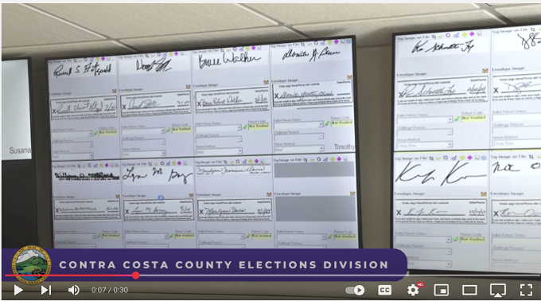
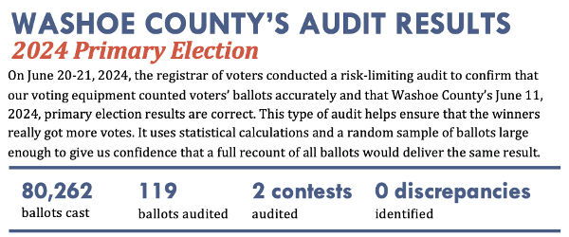
Provide facts on the vote counting process

Slide 11
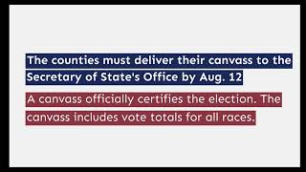
Be proactive, rather than waiting to be reactive
Pre-bunking message explaining why “Accurate Results Take Time to Count” can reduce the mistrust that comes from delayed vote counts

Slide 12
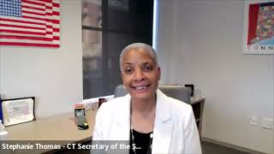
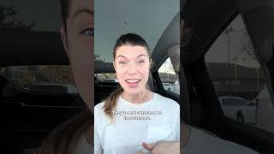
Target messages to address the concerns of different audiences
Young voters respond most to a vertical video that looks like the media they consume all day
Black communities are responsive to messages about their voting rights
Notes:
[ ] Black communities are responsive to messages about their voting rights
[ ] Young voters respond most to a vertical video that looks like the media they consume all day
[ ] Think about your audience first: Communicate a message that responds to their concerns, using the media that they use and trust

